Slide 1


Impulse metrology for fundamental physics (on behalf of the Windchime collaboration)
Credit: G.E. Marti/JILA
Jake Taylor
QuICS/JQI/NIST
-> Riverlane
@quantum_jake

Slide 2
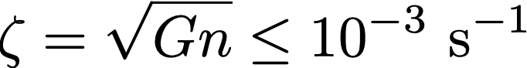
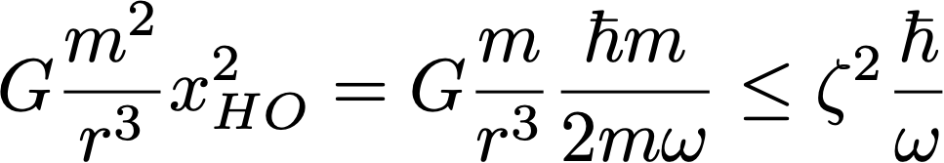
Gravity on earth: a dismal science
[ Kafri, Taylor (2013); Kafri, Taylor, Milburn (2014) ]
The natural combination of Newton’s constant G and physical parameters (material density n) defines a gravity coupling strength
This fundamental scale governs any gravity experiments we can conceive on Earth.
As an example, the quantum coupling between two harmonic oscillators:

Slide 3
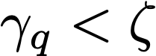
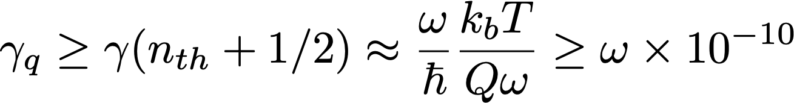
Entering the regime of ultra-coherent massive objects
Definition: an ultra-coherent massive object has a (positional) coherence time in excess of the TQG constant
Not yet realized in experiment, but now only a few orders of magnitude away!
Examples: Q-f product limits for cryogenic materials
For free-falling particles, background gas limits can be even better

Slide 4
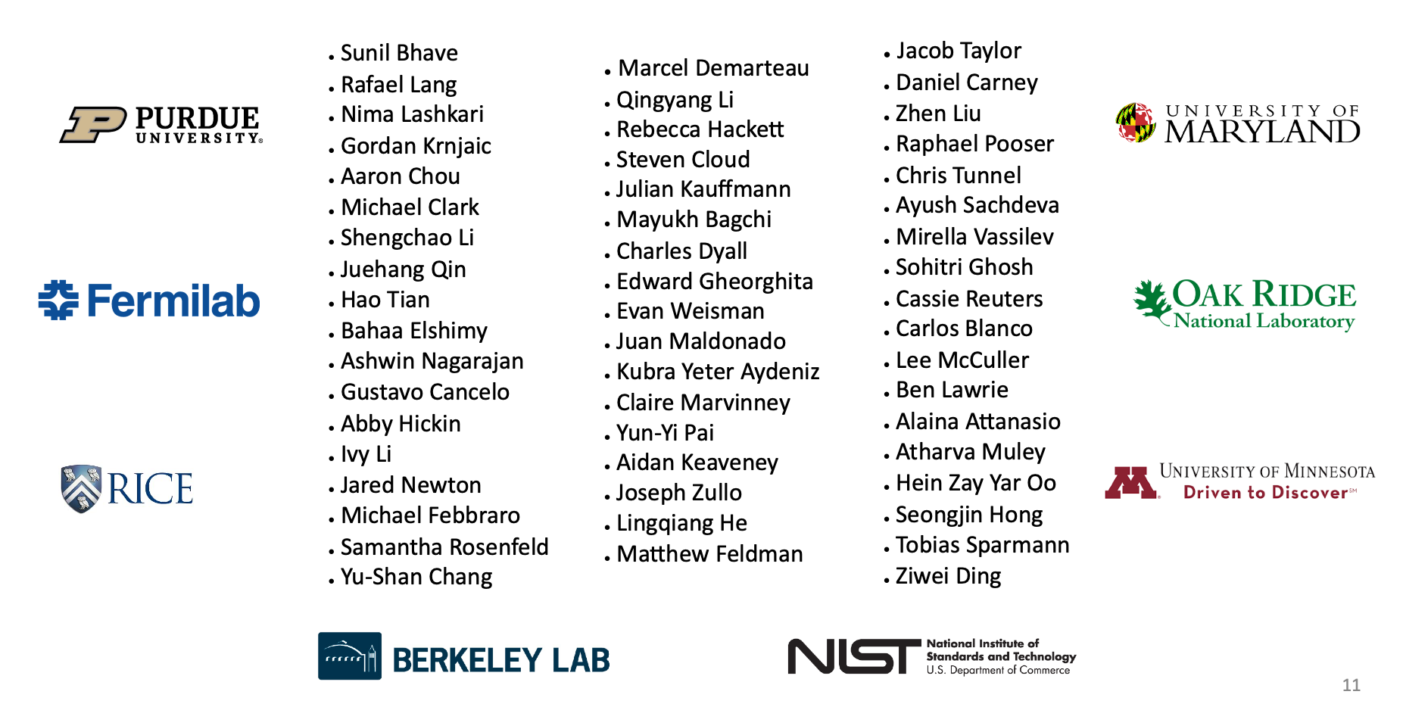
The Windchime project

Slide 5
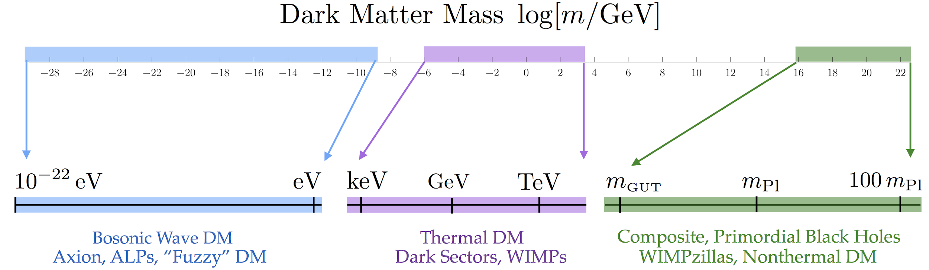
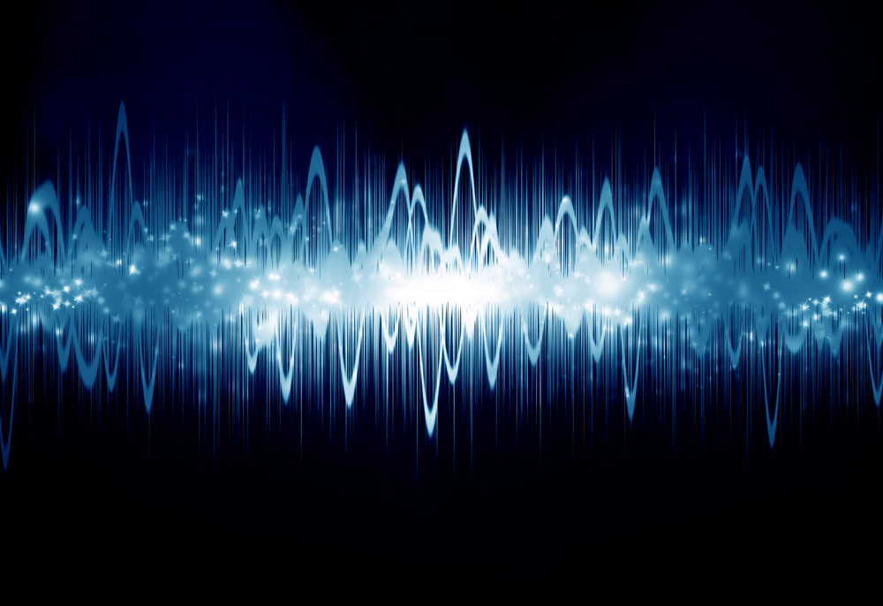
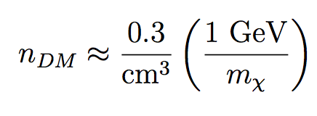
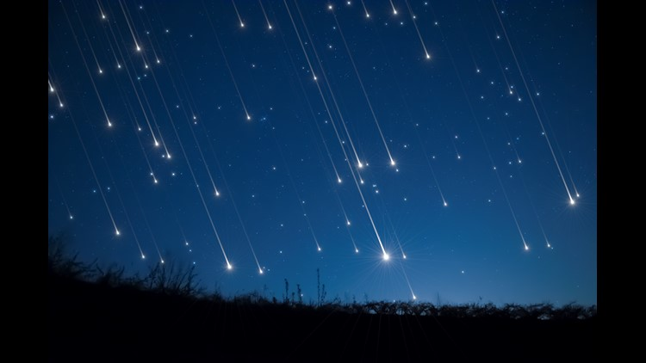

The dark matter spectrum of uncertainty

Slide 6
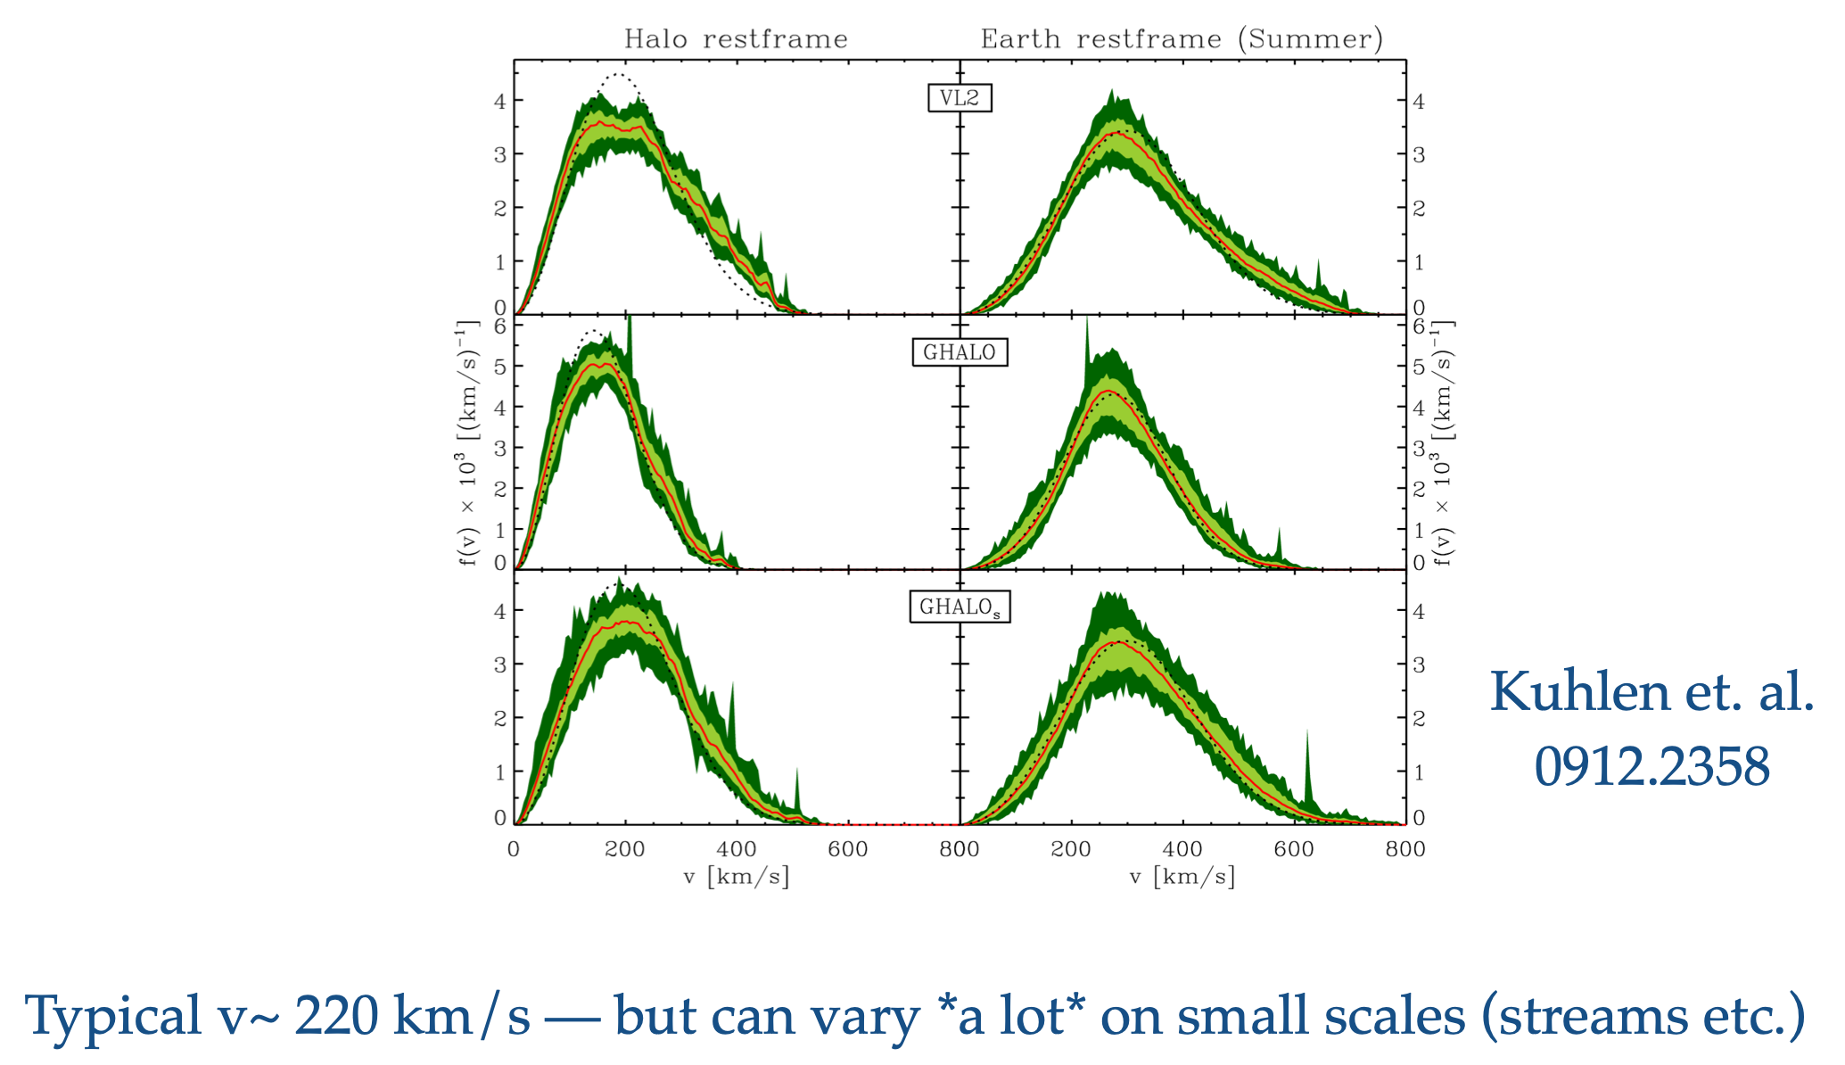
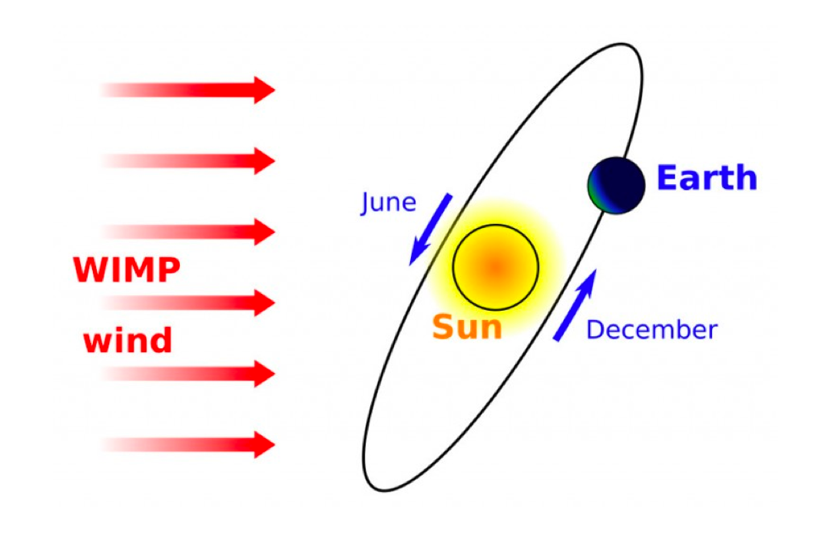
The dark matter “wind”

Slide 7
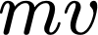
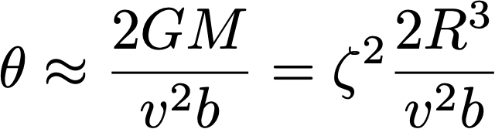

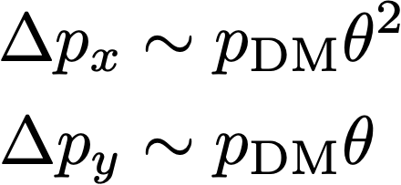
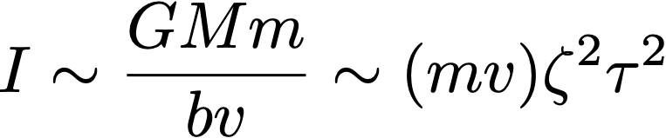
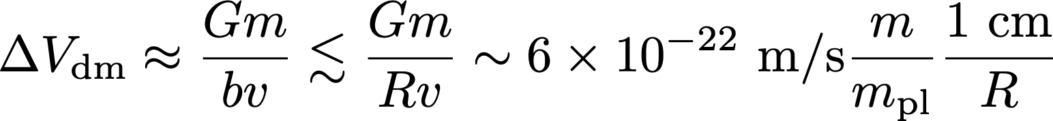
b
Gravity only?

Slide 8
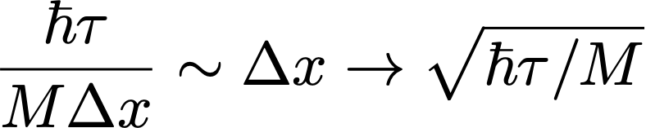
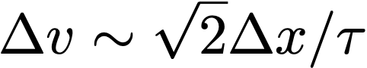
Going to velocity measurement and the free-particle ‘SQL’
X(1)
X(2)
V(2) = (X(2)-X(1))/t
X(3)
V(3) = (X(3)-X(2))/t
Position standard quantum limit
Velocity standard quantum limit (numerical differentiation)
Longer times, higher masses => better SQL

Slide 9
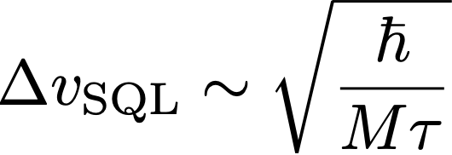
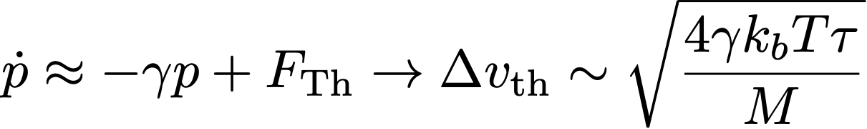
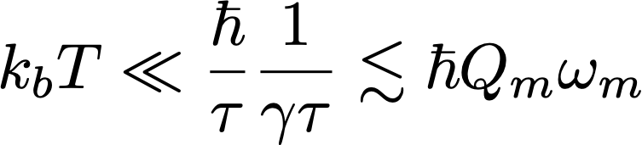
Thermal limits to velocity measurement
Long integration times lead to accumulation of thermal noise
We become SQL limited in the quantum coherent limit

Slide 10
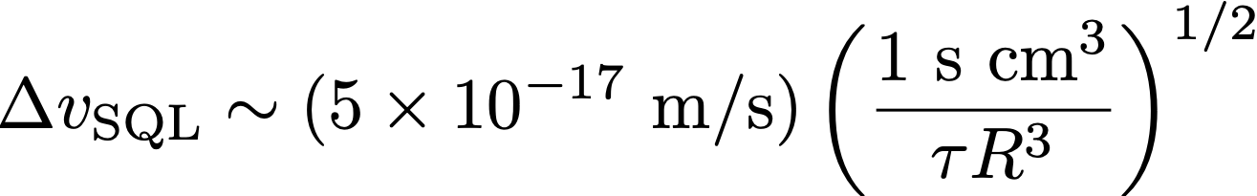
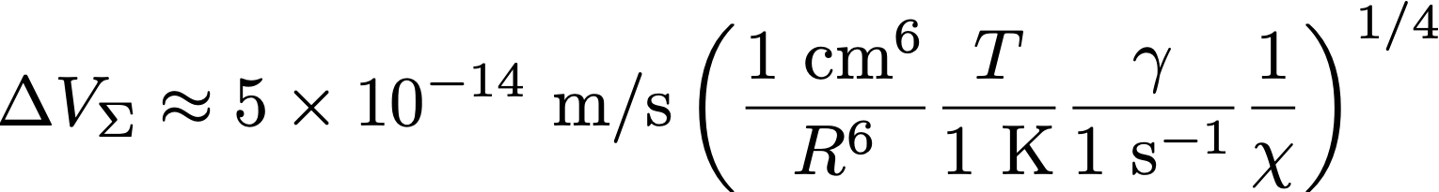
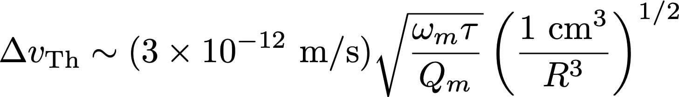
Comparison to expected velocities? Attometer per second
Assumes 10 mK temperatures, dark matter velocity of 200 km/s, Indium or similar density material sphere, and impact parameters comparable to sphere radius R

Slide 11
Path towards single sensor realization
Larger mass
Lower heating rate
Use of squeezing and back action evasion

Slide 12
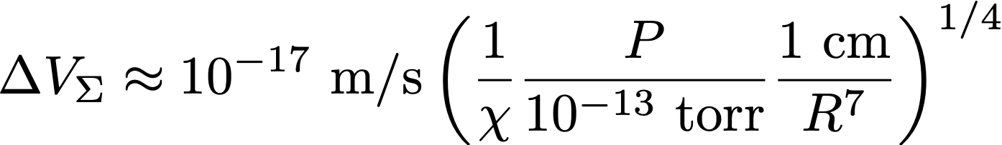
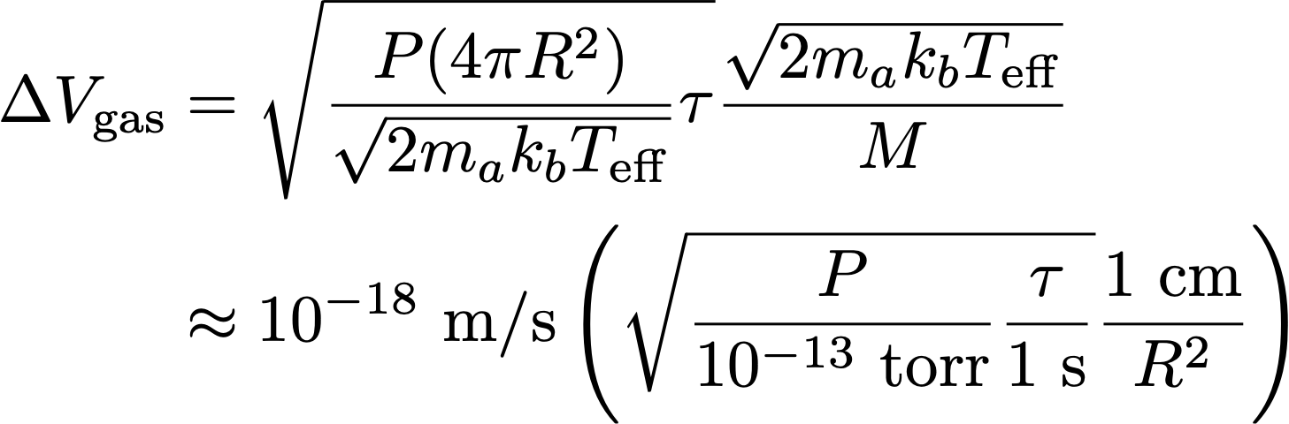
Lower heating rate? Free falling masses
Background gas leads to impulse noise (atoms bouncing or sticking to the mass)
Collisions
Velocity change per collision
Blackbody radiation leads to positional dephasing as microwaves rethermalize in changing boundary conditions (unintended position measurement!)

Slide 13
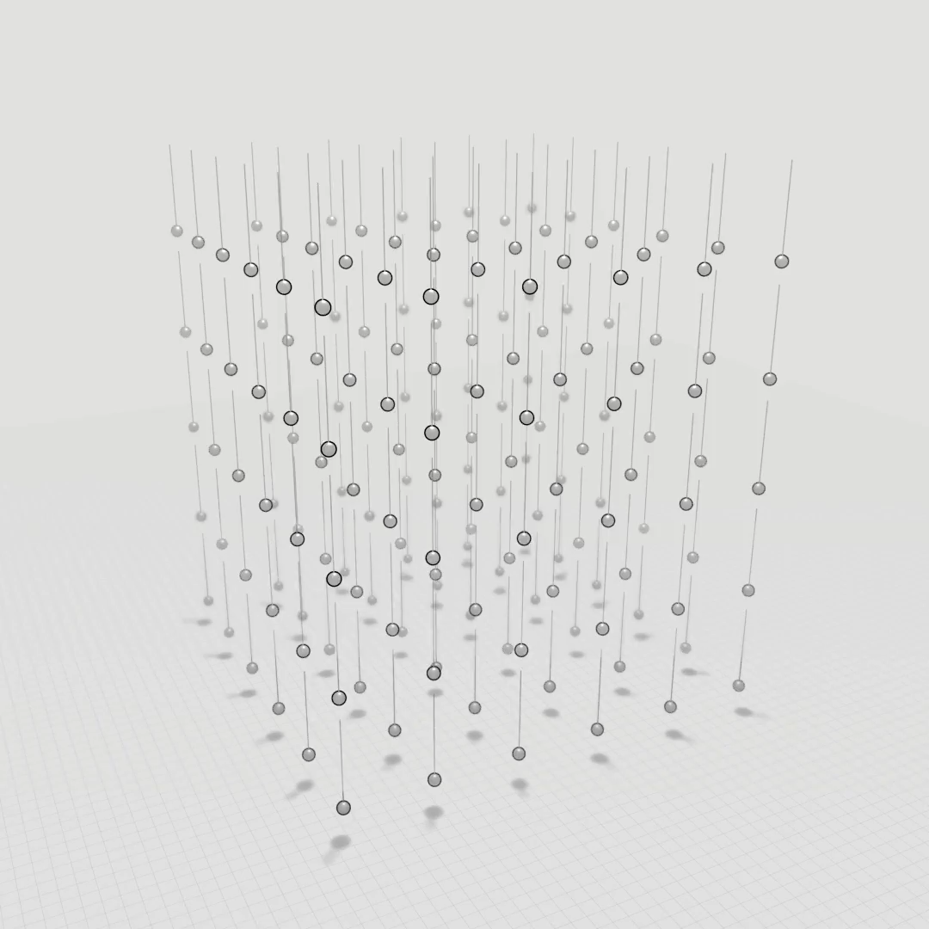
D. Carney, S. Ghosh, G. Krnjaic, J. M. Taylor, 1903.00492
S. Ghosh, D. Carney, P. Shawhan, J. M. Taylor, 1910.11892

Slide 14
Snowmass 2021 White Paper: The Windchime Project (arXiv: 2203.07242)

Slide 15
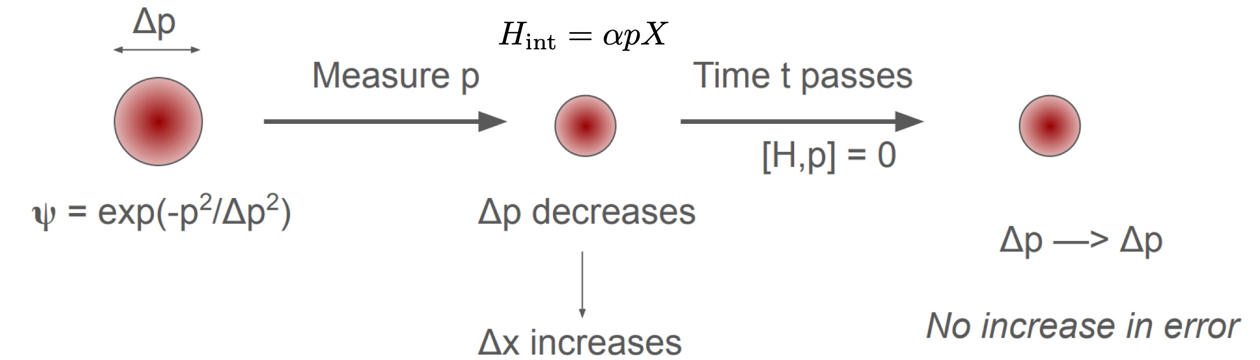
Back action evasion? Take advantage of monitoring velocity!

Slide 16
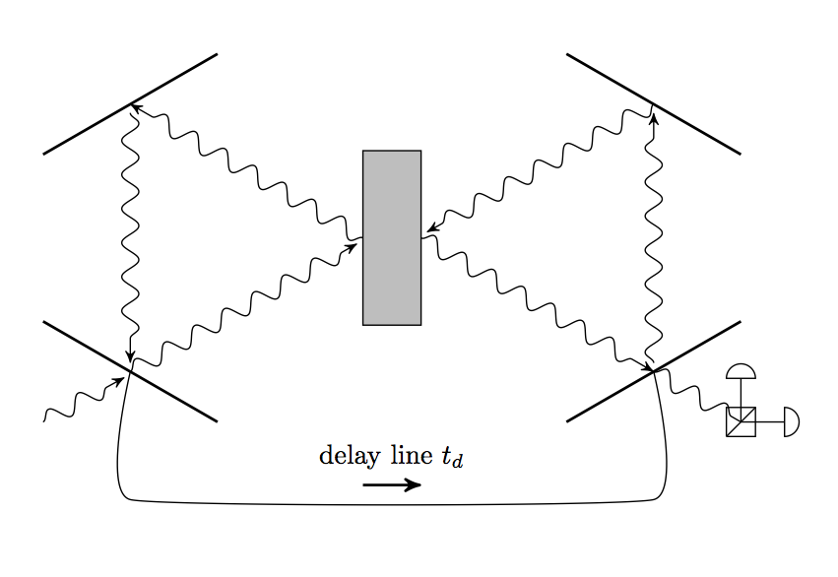
Impulse measurements naturally reduce noise
Braginski 1989
Ghosh et al. PRA 2020
light phase ~ x(t₁)
impart +p to mirror
light phase ~ -x(t₂)
impart -p to mirror
→ Output light phase ɸ ~x(t₁)-x(t₂) ~ v, optical momentum transfer to sensor Δp ~0
→ No net radiation pressure (“backaction noise evasion”) for a free-falling particle
Monitoring the momentum of a free-falling mass is a (nominal) quantum non-demolition measurement — can go well beyond SQL

Slide 17
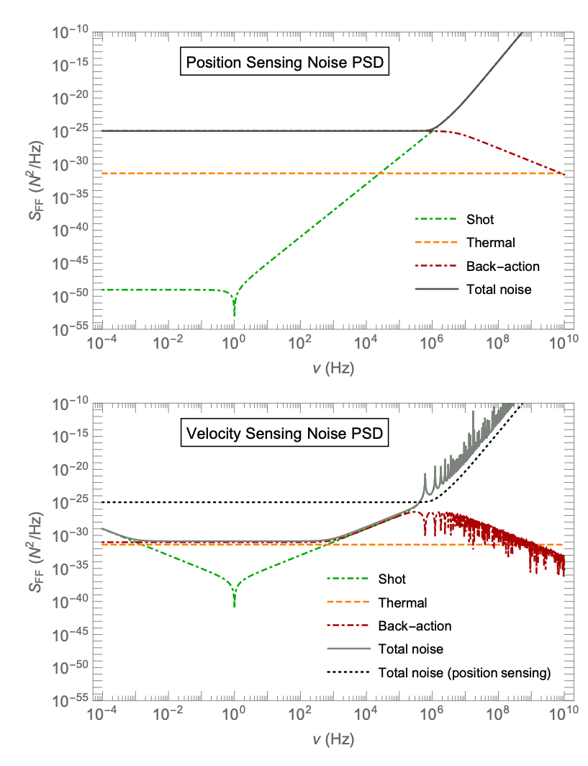
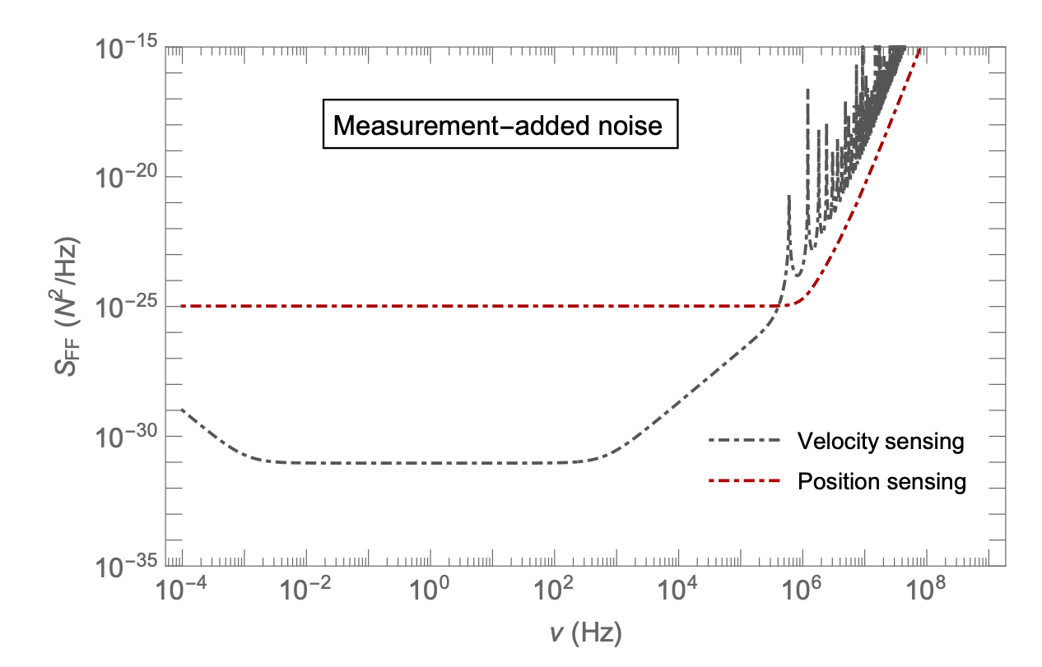
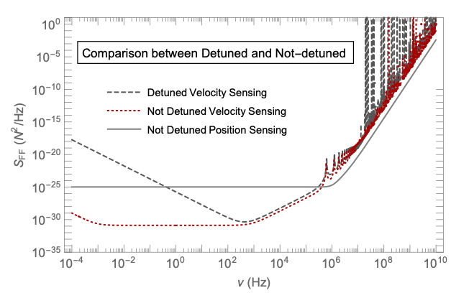
Impulse measurements naturally reduce noise
Braginski 1989
Ghosh et al. PRA 2020
Example numbers:
A 1 Hz, Q ~ 10⁴ mass at 10 mK (close to free mass limit)
An optical cavity with 10 MHz loss
A 1 µs delay with a loss of < 0.01%
And we are targeting impulses of duration ~ 1 µs
Detection Band
Key point: working well above resonance requires substantial laser power, and has different tradeoffs
Estimate for these numbers? 30 dB evasion
[ Ghosh et al., PRA (2020) ]

Slide 18
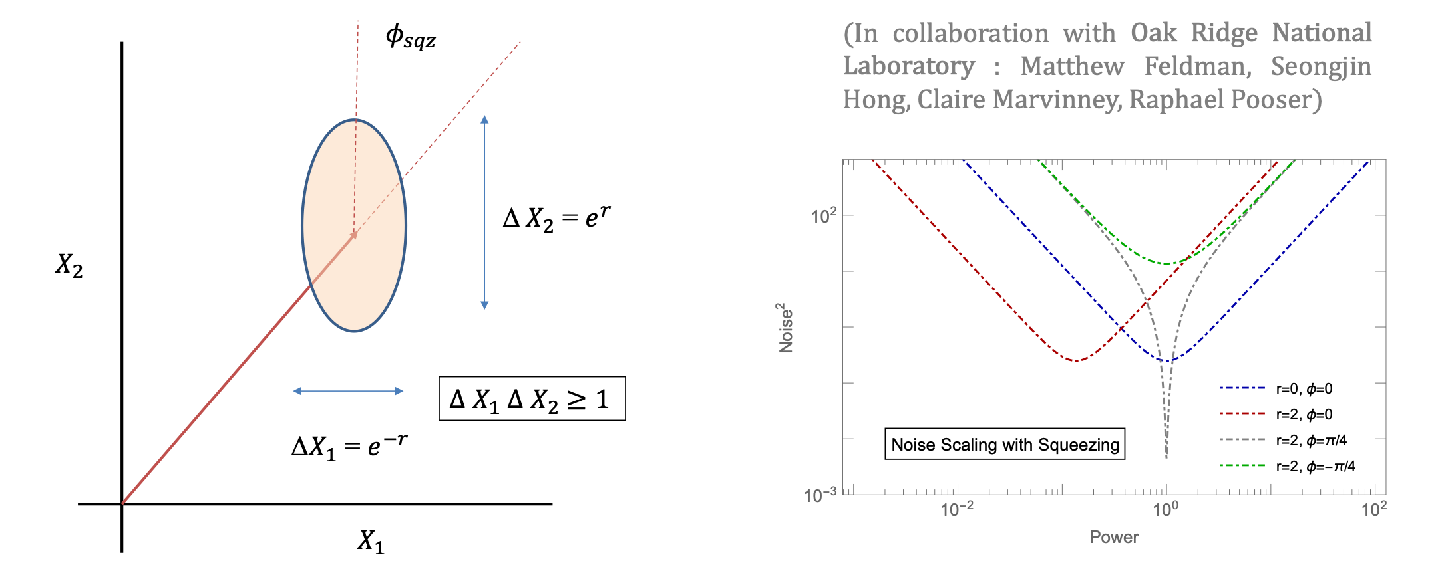
Squeezing pairs well with back action evasion
[ poster by Sohitri Ghosh today ]
We can work at phase quadrature
There is no frequency and/or power dependence to the measurement angle
Squeezing is a pure win on power

Slide 19
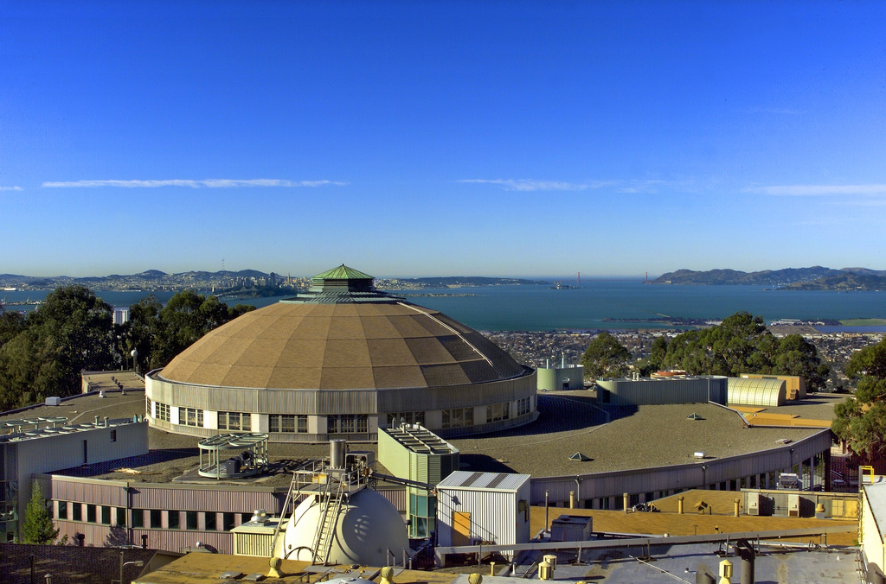

Work with us on windchime!
We are hiring a theory postdoc to work on Windchime-related projects at Berkeley Lab.
Job posting open until July 1 (https://academicjobsonline.org/ajo/jobs/21425)
Reach out for details/if you want to apply but can’t make July 1: carney@lbl.gov

Slide 20
The Windchime project

